Slide 1
Premier League Goals & Weather Analysis
EDA & Hypothesis Testing
Mazen Zeybek
00033539

Slide 2
My Data sets
Premier League datasets including all matches for (2000/2001, 2001/2002, 2020/2021, and 2021/2022) downloaded from kaggle
Weather datasets for the same time periods purchased on Visual Crossing

Slide 3
Data cleanup
Cleaned up and sorted my data for effecieny with a python code written with the help of LLM’s
Instead of having separate weather files for each city and a different premiere league files, I merged each seasons weather and prem stats keeping only the necessary columns for EDA and Hypothesis tests, now just having 4 files in total.

Slide 4
Outline
Data Overview
Seasonal Goals Comparison
Weather Impact
Temperature Effects
Attendance Impact
VAR Era Comparison
Time-of-Day Analysis
Hypothesis Testing
Conclusions

Slide 5
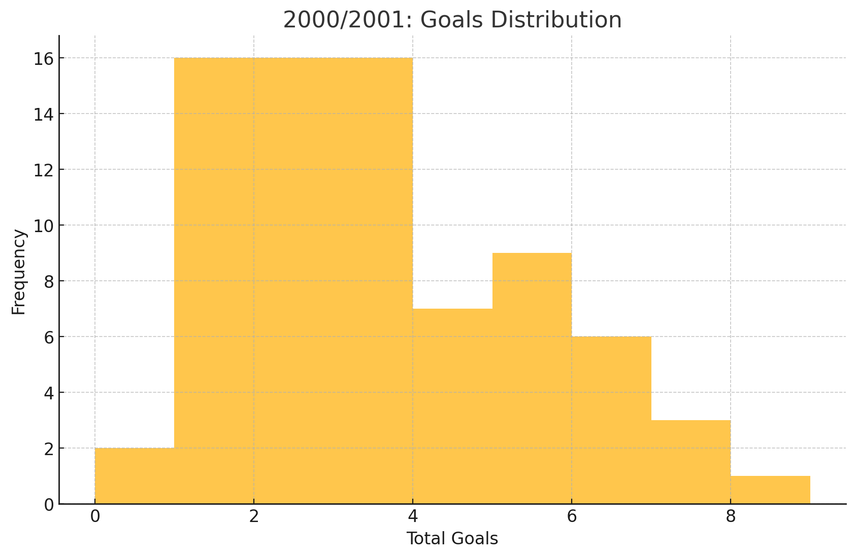
2000/2001: Goals Distribution
Average goals per match = 3.08

Slide 6
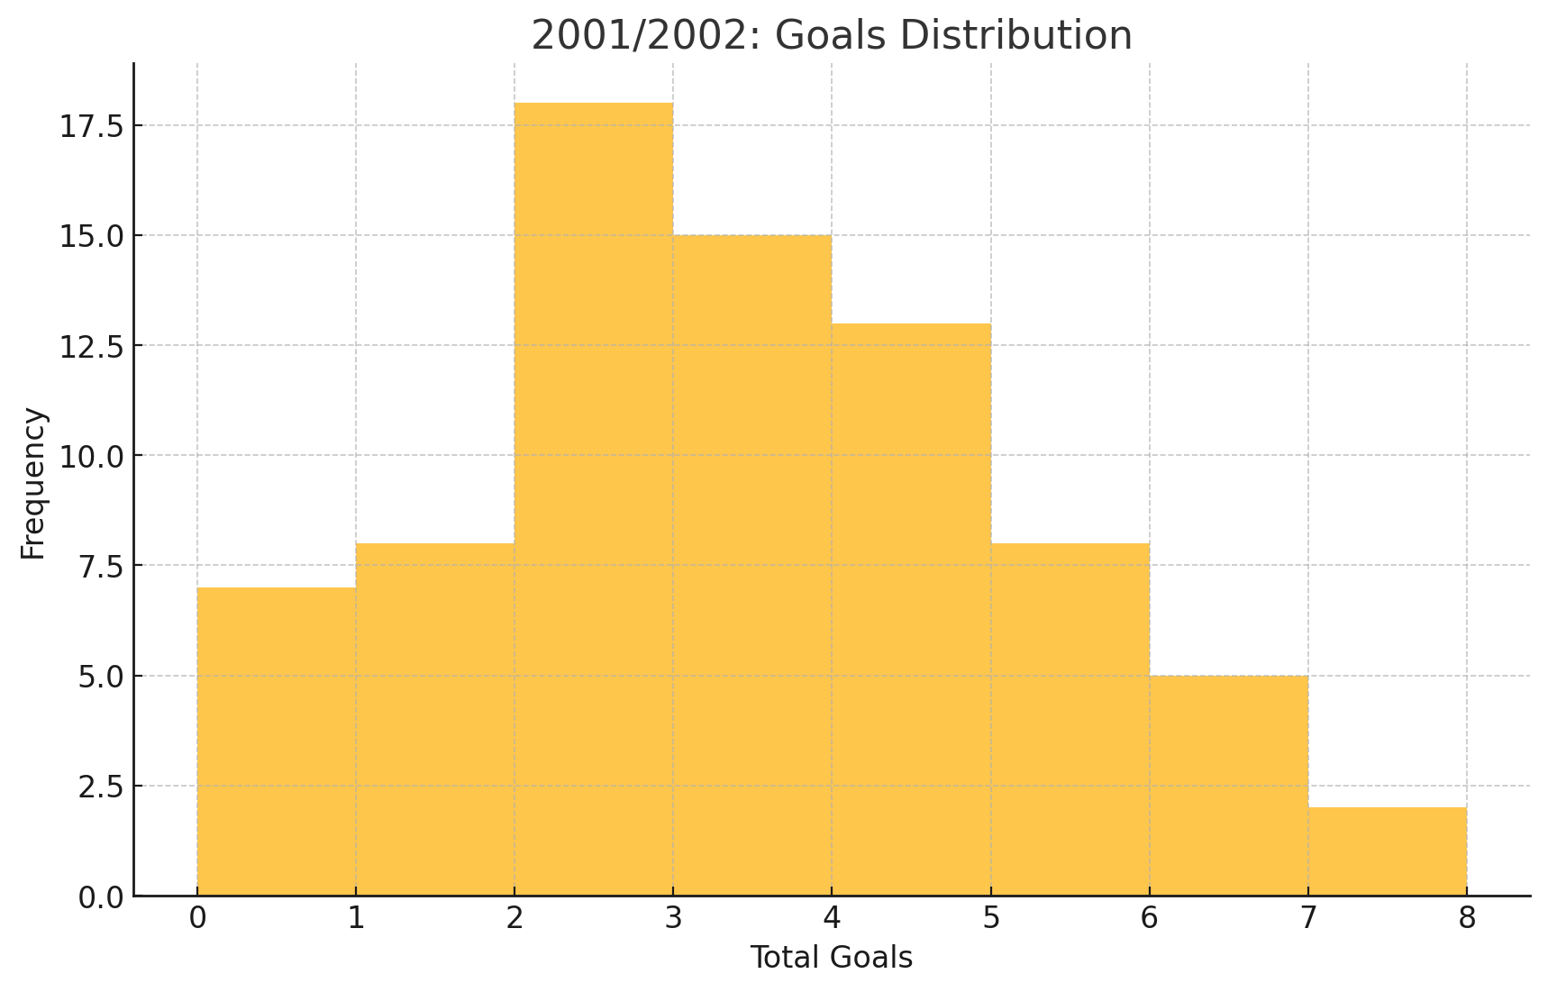
2001/2002: Goals Distribution
Average goals per match = 2.96

Slide 7
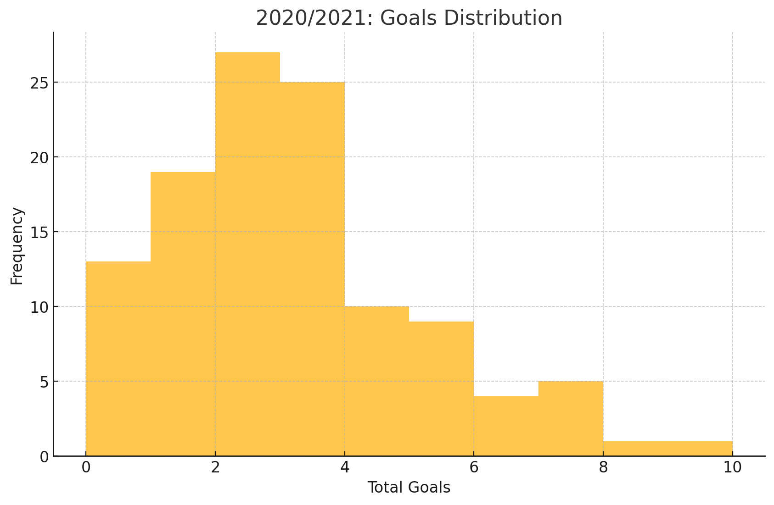
2020/2021: Goals Distribution
Average goals per match = 2.71

Slide 8
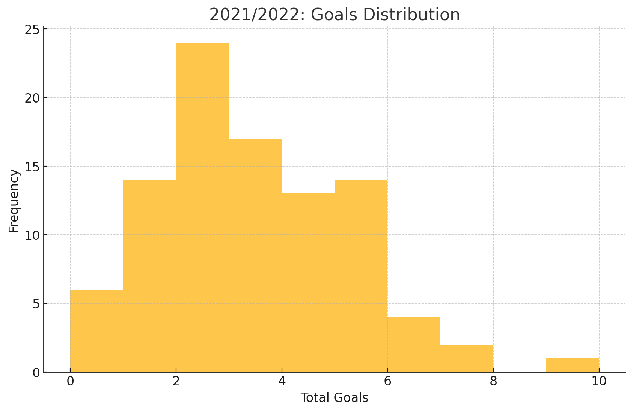
2021/2022: Goals Distribution
Average goals per match = 2.97

Slide 9
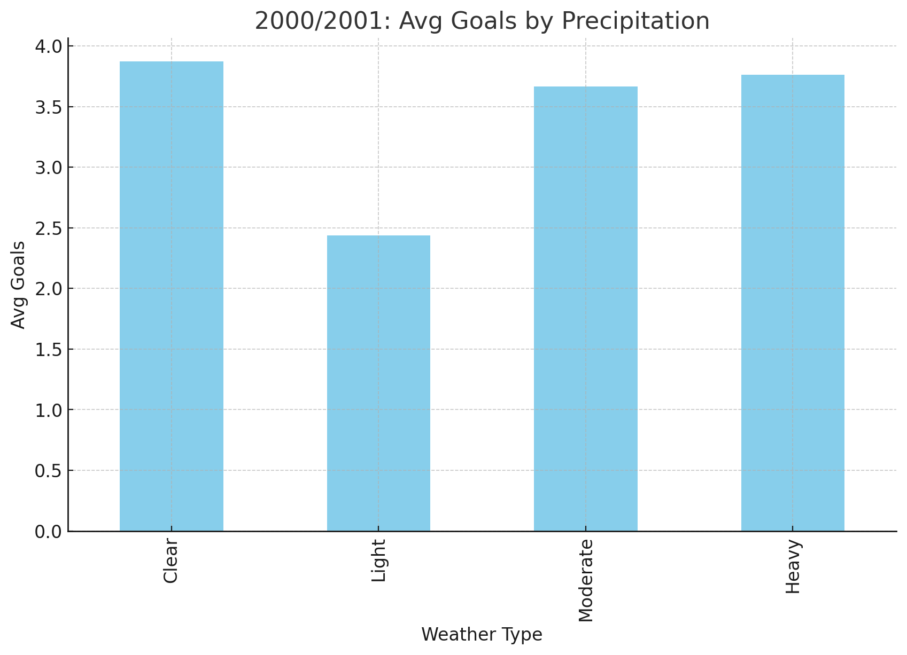
2000/2001: Weather Impact
In the 2000/2001 season there seems to be no significant correlation between weather and precipitation levels,
Clear weather has a similar avg of goals with , moderate and heavy precipitation.
While Light precipitation (light rain) seems to show a decrease in the avg number of goals scored

Slide 10
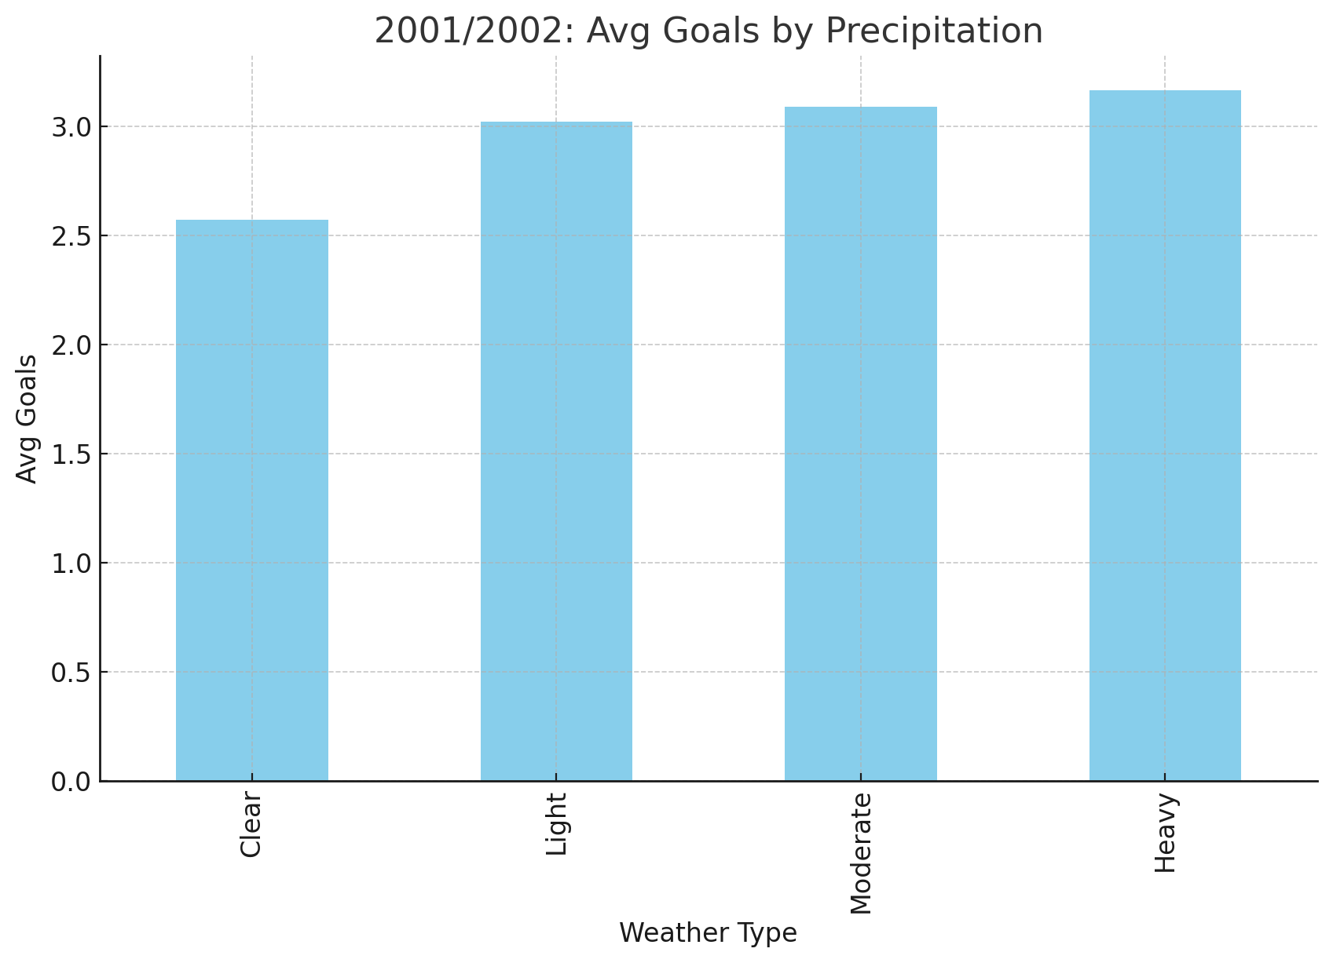
2001/2002: Weather Impact
In the 2001/2002 season there seems to be no significant correlation between weather and precipitation levels.
Light, moderate and heavy precipitation all to have a very close avg goals scored.
While clear weather seems to show a decrease in the avg number of goals scored

Slide 11
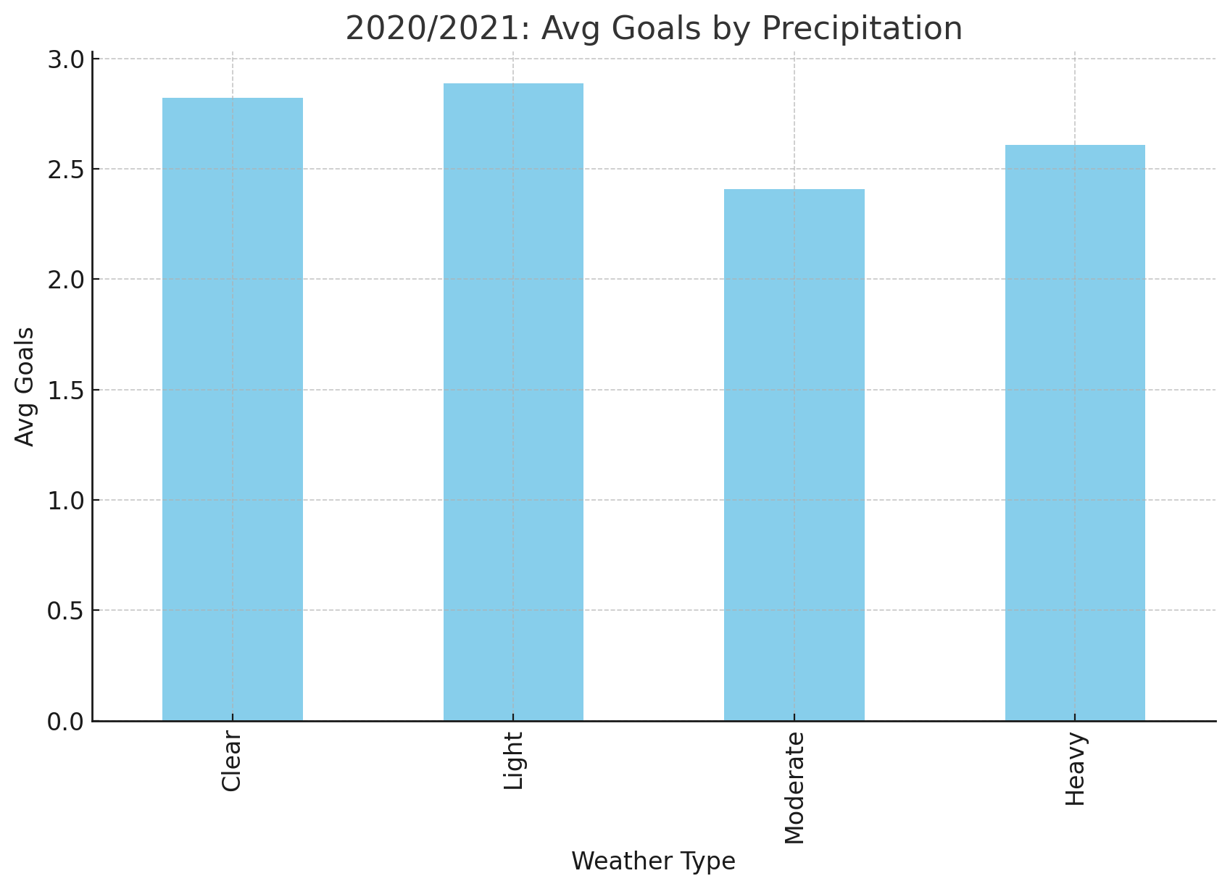
2020/2021: Weather Impact
In the 2020/2021 season there seems to be no significant correlation between weather and precipitation levels.
Clear weather and all precipitation levels have a similar number of avg goals scored

Slide 12
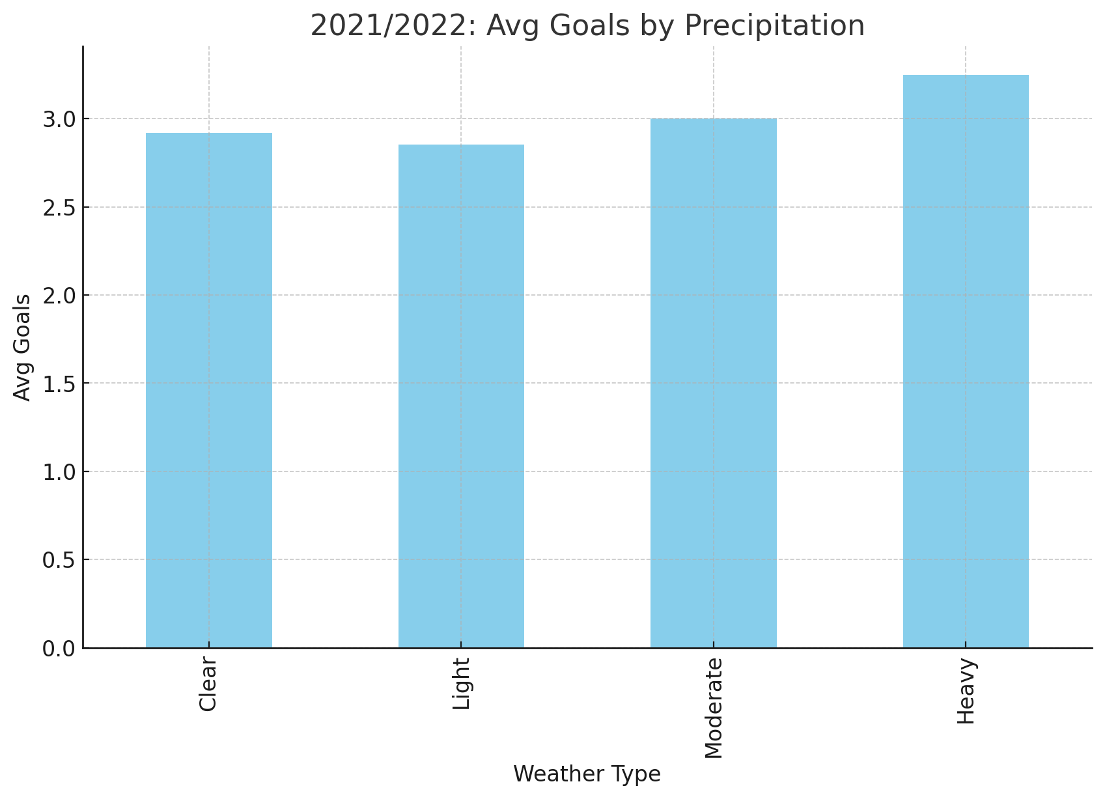
2021/2022: Weather Impact
In the 2020/2021 season there seems to be no significant correlation between weather and precipitation levels.
Clear weather and all precipitation levels have a similar number of avg goals scored

Slide 13
Conclusion?
Weather does not have a significant correlation with the average number of goals scored. In the 4 seasons we compared there was no solid conclusion we could get to, the only difference we saw was in the 2000/2001 season where light percipitation had a significantly lower avg num of goals but this was inconsistent in the other 3 seasons.

Slide 14
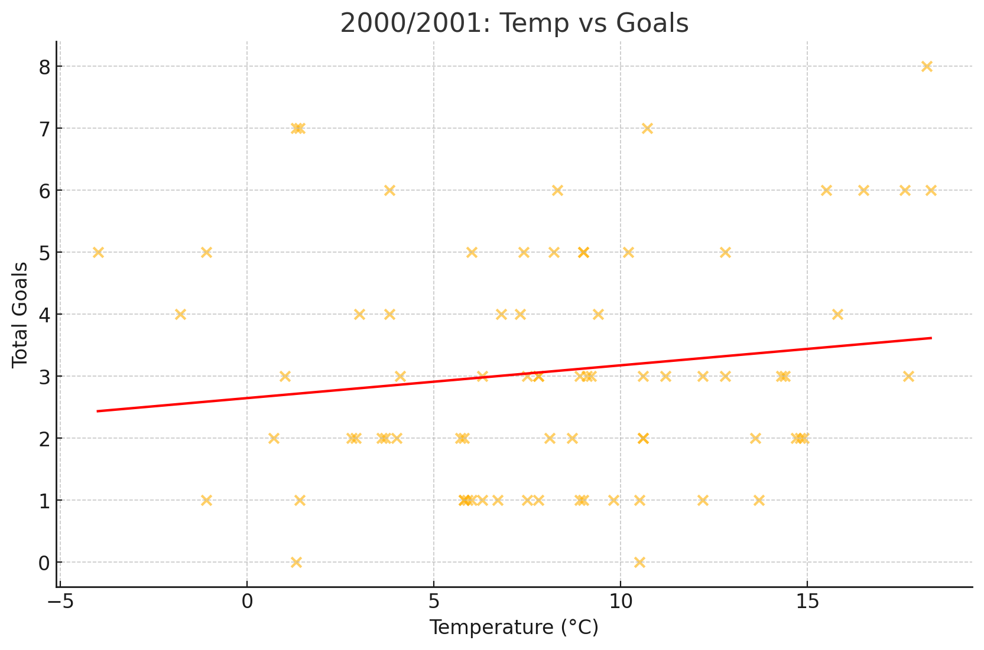
2000/2001: Temperature Effects
Corr r=0.14

Slide 15
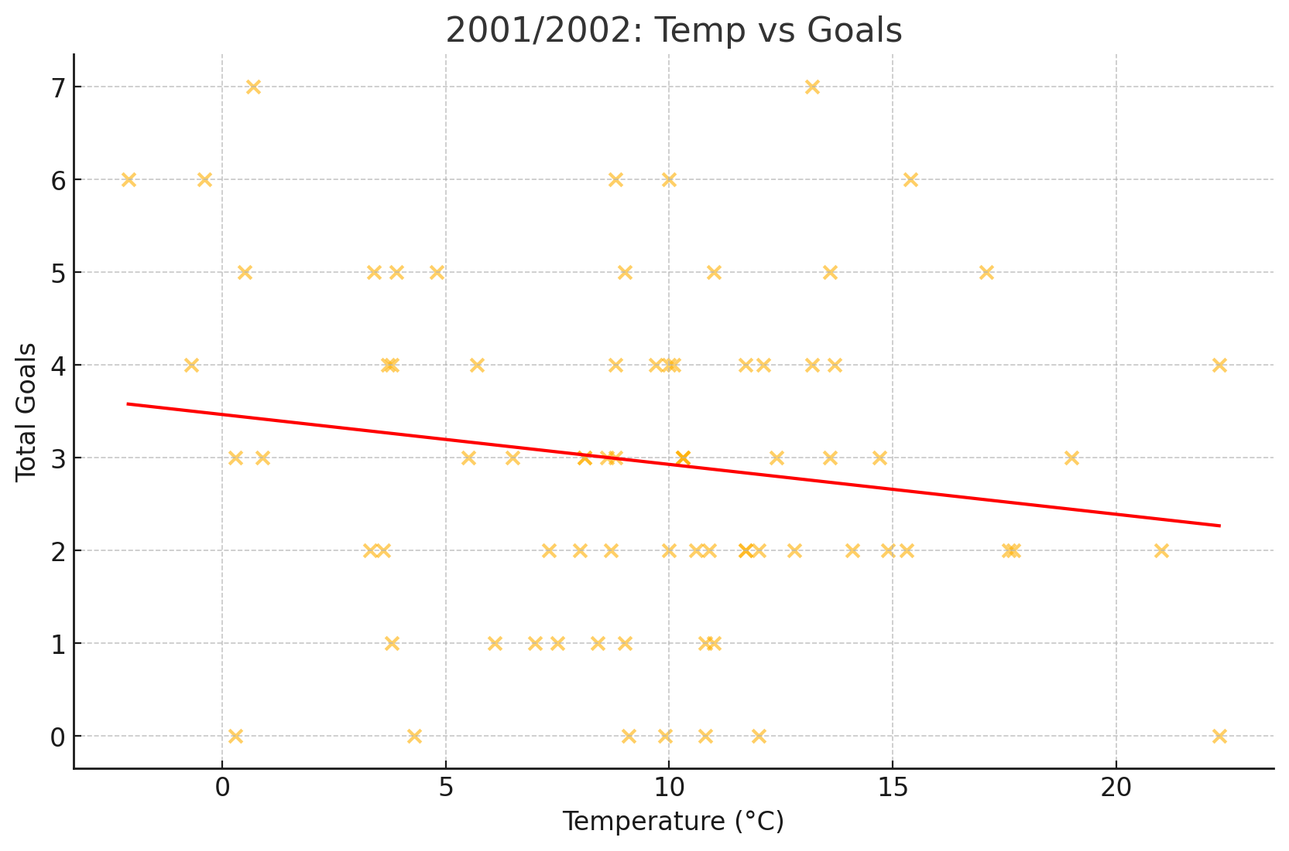
2001/2002: Temperature Effects
Corr r=-0.16

Slide 16
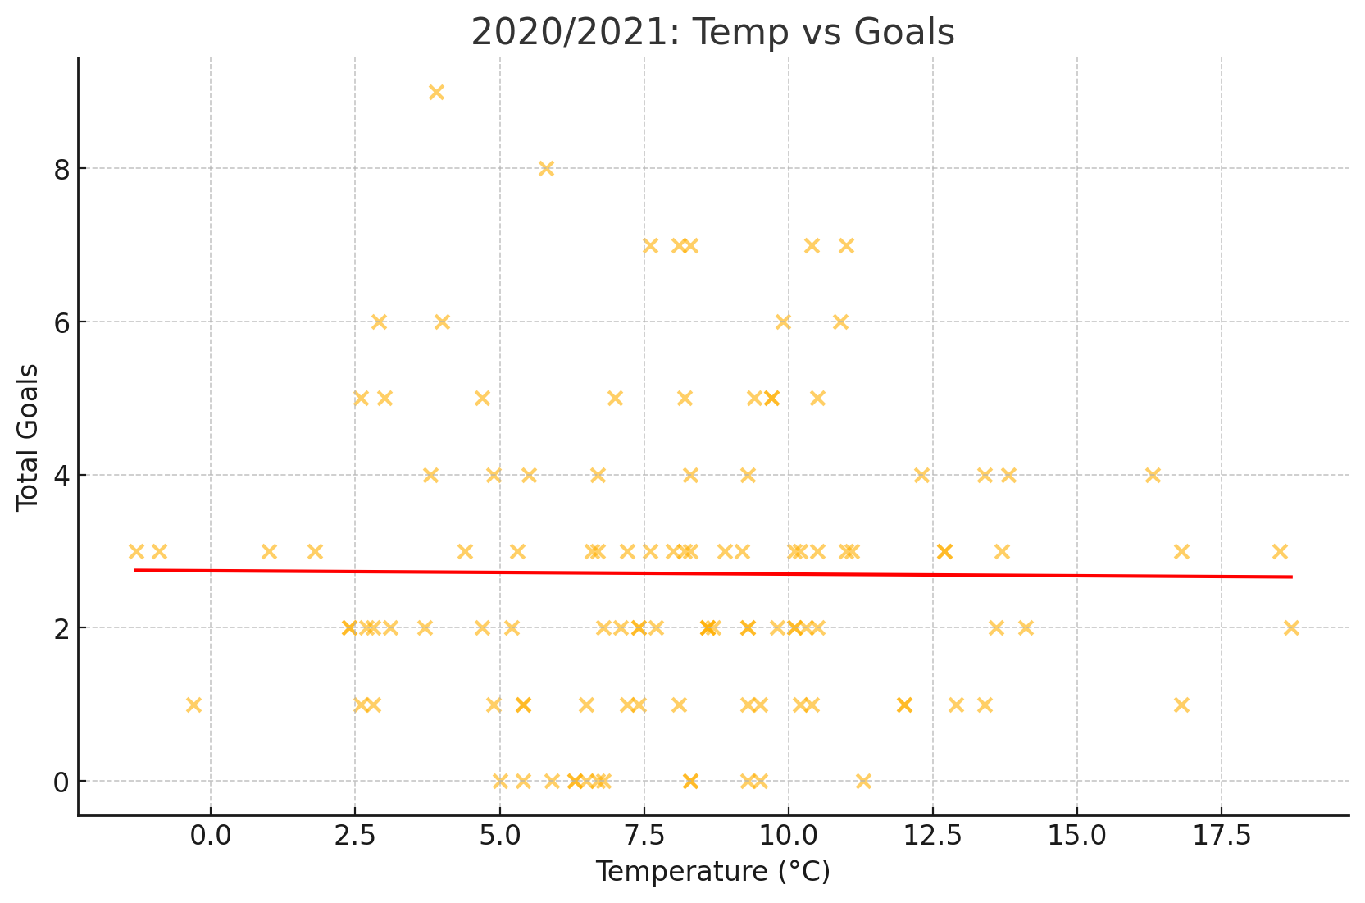
2020/2021: Temperature Effects
Corr r=-0.01

Slide 17
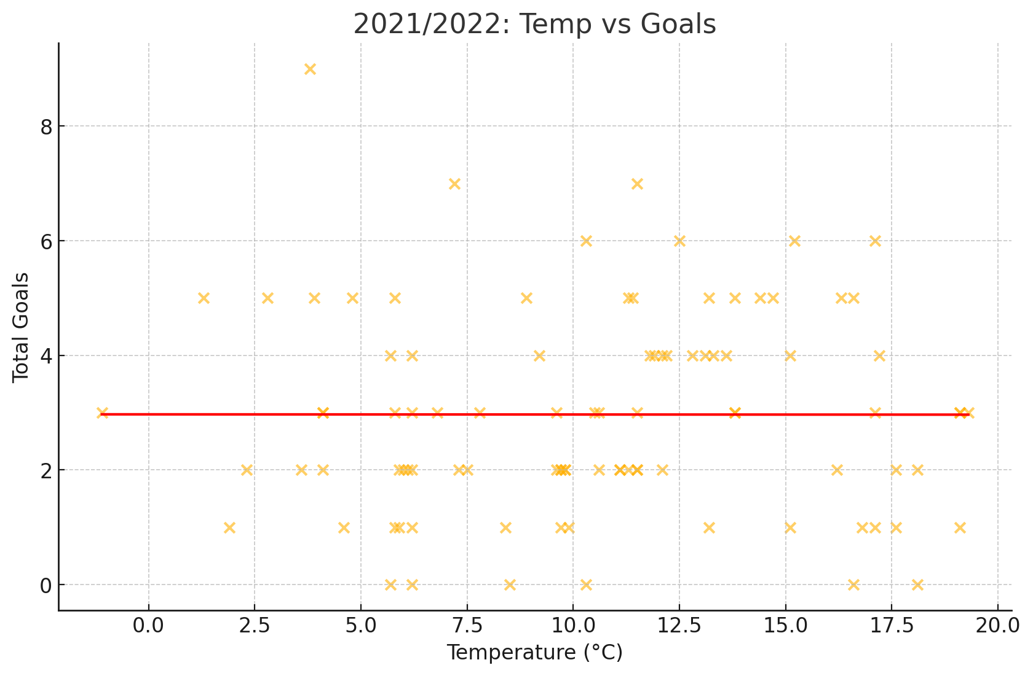
2021/2022: Temperature Effects
Corr r=-0.00

Slide 18
DID TEMPERATURE HAVE AN EFFECT ON THE AVG NUMBER OF GOALS SCORED?
In all four seasons the Correlation Coeffecient was too low and even was 0 in the 2021/2022 season, showing us that there is no correlation between temperature and the amount of goals scored.

Slide 19
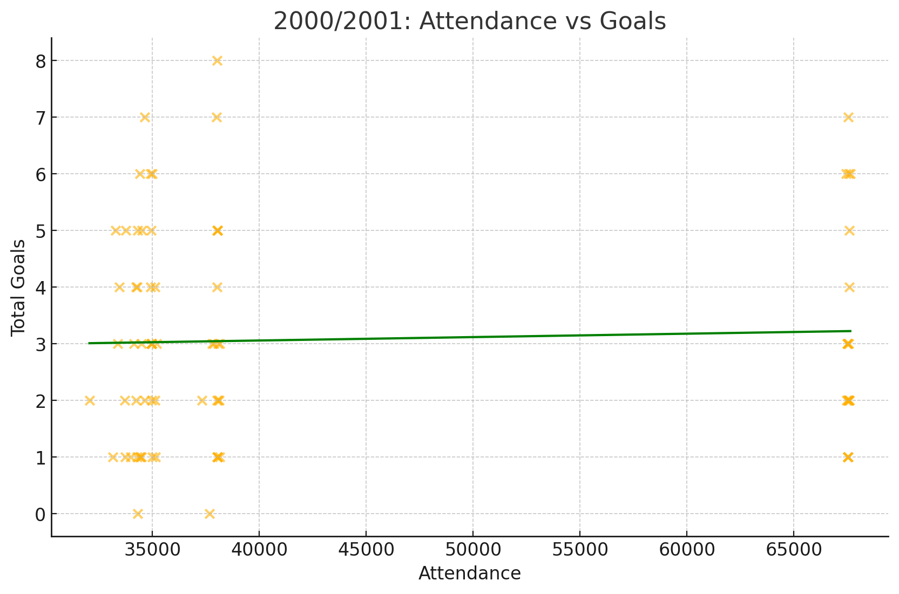
2000/2001: Attendance Impact
Corr r=0.04

Slide 20
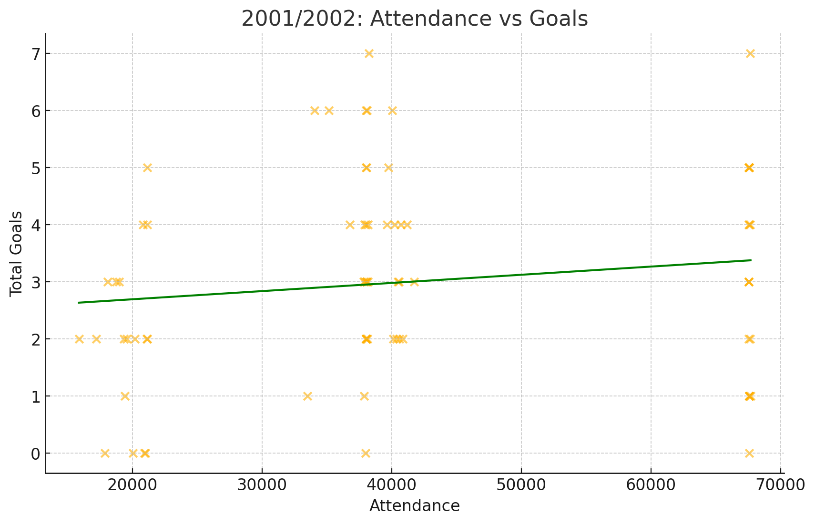
2001/2002: Attendance Impact
Corr r=0.14

Slide 21
Attendance vs goals scored
The correlation coefficient was also too low to be of any significance, showing us that attendance has a very minimal effect on the number of goals scored.

Slide 22
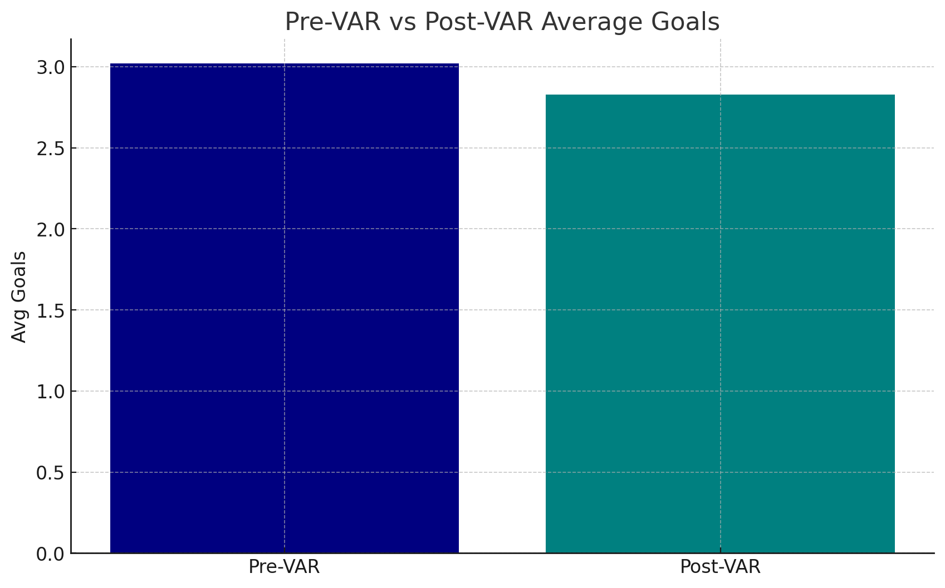
VAR Era Comparison
Pre-VAR avg = 3.02, Post-VAR avg = 2.83, t=-0.97, p=0.332. No significant change between
Pre-VAR and Post-VAR seasons.

Slide 23
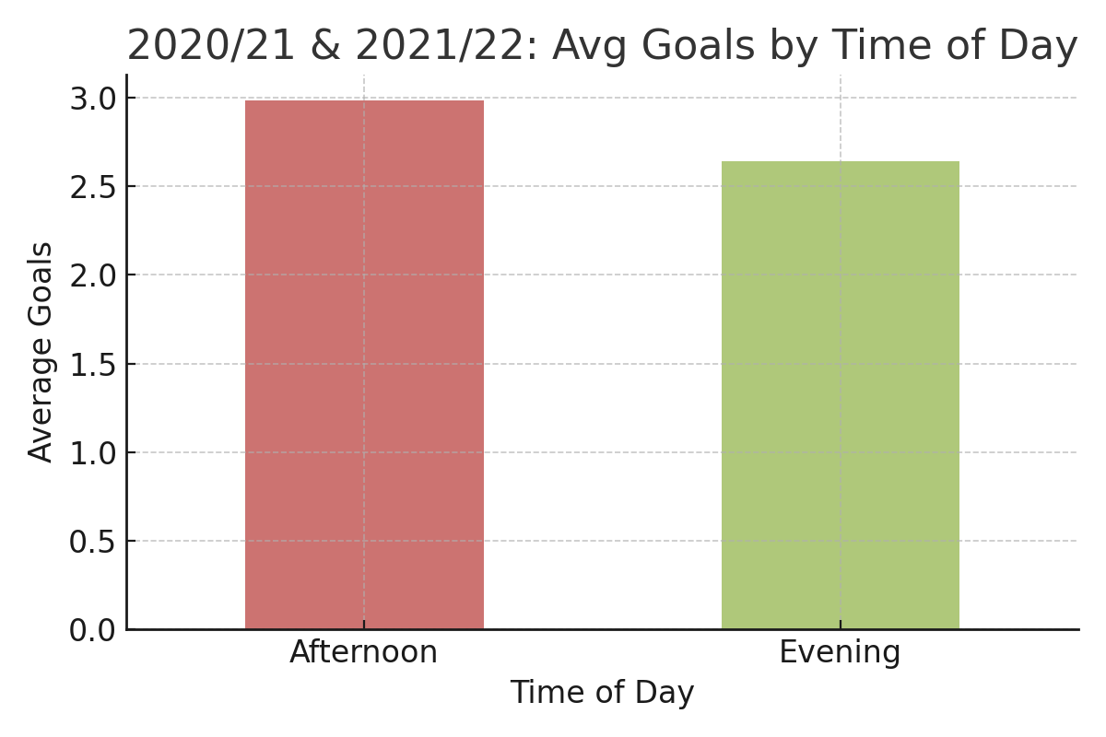
Time-of-Day Goals Comparison
Afternoon matches (n=114) averaged 2.98 goals per match. Evening matches (n=95) averaged 2.64 goals per match.
Very similar average goals indicating time of day has no significant effect on goals scored

Slide 24
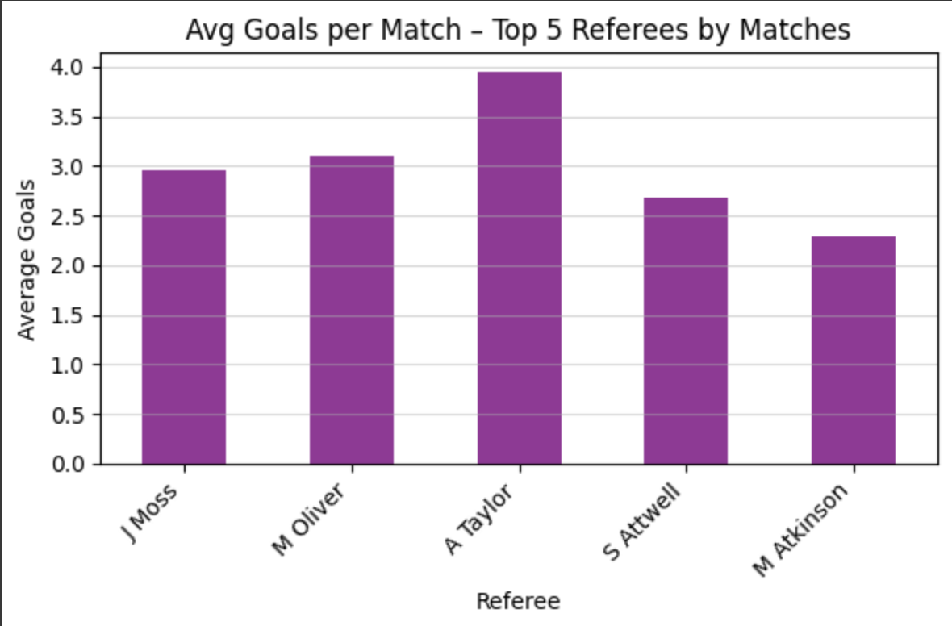
Referee Impact on Goals Per Match
BAR CHART: Average goals per match for the top 5 referees (≥10 matches)
Note: Only referees with ≥10 matches considered.

Slide 25
Referee Impact - Key Takeaways
Referees tested: top 5 by match count
Range of average goals: ~2.8 to ~3.2 goals per match
Small variability compared to overall avg (~3.0 goals)
No single referee drives large scoring changes
Referee identity has minimal effect on total goals

Slide 26
Hypothesis Test: Heavy Rain vs Clear
H0: μ_heavy = μ_clear (heavy rain has no impact on the number of goals scored)
H1: μ_heavy ≠ μ_clear (heavy rain does impact the number of goals scored)
Heavy (n=67 games) mean=3.10 goals
Clear (n=87 games) mean=2.92 goals
t=0.54, p=0.589 → Fail to reject H0
Means that there is no significant difference in goals scored when theres heavy rain and when the weather is clear

Slide 27
Conclusions
Seasonal scoring distributions are stable (avg ~3.0 goals).
Weather has minimal effect on goals scored
Temperature shows negligible correlation (r<0.3).
Attendance impact is weak (r<0.3) across seasons.
VAR introduction had no significant effect on avg goals.

